Slide 1

Real Time Streaming Data Web Deployment
CVR COLLEGE OF ENGINEERING
22B81A05AQ
22B81A05BA
22B81A05Z7
Avadootha Rajesh
Sulva Sai Ram
Barishetty Durga Sai Vigneshwar
Under the guidance of
Ratna Sirisha
Professor Incharge

Slide 2
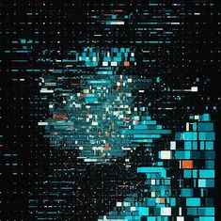
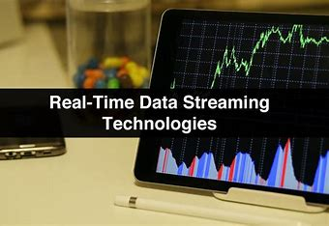
Abstract
Project Overview : A web application that displays real-time stock prices using TradingView widgets.
Objective : To provide users with live stock data in an easy-to-navigate interface.
Technology : Integrates TradingView widgets for accurate and up-to-date financial data visualization.
Real-Time Data : Offers continuous stock price updates, enhancing user decision-making.
Impact : Supports traders and investors by providing a streamlined platform for tracking market trends.

Slide 3
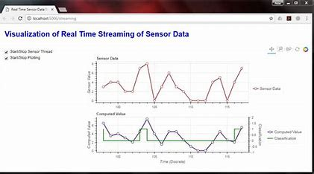
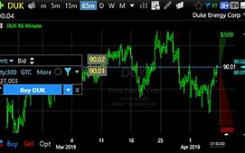
Introduction
Project Name : Real-Time Streaming Data Web Deployment.
Purpose : Create a platform that delivers live stock market data to users.
Technology : Utilizes TradingView widgets for embedding real-time stock price charts and information.
Target Audience : Traders, investors, and users interested in monitoring stock markets.
Key Features :
- Continuous streaming of stock prices.
- Interactive charts for user engagement.
- Accessible interface for easy stock tracking.
Goal : Enhance the user’s ability to monitor financial data and make informed decisions.

Slide 4
Related works/ Literature survey
Real-time Data Streaming : Essential for financial apps using WebSockets and APIs; TradingView provides reliable widgets for this.
Stock Market Analysis Tools : TradingView stands out with developer-friendly customization compared to tools like Yahoo Finance or Bloomberg.
Data Visualization : Libraries like D3.js and Chart.js are popular, but TradingView simplifies real-time stock visualizations.
Web Application Architecture : The MERN stack is effective for real-time apps; React integrates well with TradingView for live data.
API and Widget Integration : TradingView’s widgets simplify real-time financial data integration, reducing manual effort.

Slide 5
Proposed solution / Methodology
Real-time Data Integration : Leverage TradingView widgets to fetch and display live stock prices seamlessly within the MERN application.
Frontend Design : Utilize React for the user interface, ensuring responsive and interactive visualizations for stock data.
Backend Support : Set up Node.js with Express to manage API calls, user requests, and any server-side logic required for data processing.
Data Presentation : Implement clear, intuitive stock price charts and market trends using TradingView’s pre-built visualization tools.
User Interaction : Ensure smooth navigation and allow users to filter or track specific stocks with real-time updates.

Slide 6



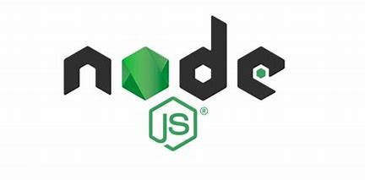

Technology stack
Frontend :
React : For building the user interface and managing component-based architecture.
TradingView Widgets : For real-time stock price charts and visualizations.
CSS/Bootstrap : For responsive design and UI styling.
Backend :
Node.js : For server-side logic and handling API requests.
Express.js : As the web framework for routing and managing backend services.
Database :
MongoDB : For storing user data, preferences, and stock-related information (optional, based on the project's needs).
API :
TradingView : For fetching real-time stock market data.
Hosting :
Heroku/Netlify : For deploying the application (depending on the need for backend services).

Slide 7

Future plans
Integrate More Data Sources : Expand stock market coverage with real-time data from additional exchanges and include cryptocurrencies.
Advanced Analytics : Implement stock prediction tools, historical data analysis, and personalized insights for users.
User Accounts : Add user features for watchlists, notifications, and personalized dashboards.
Mobile Optimization : Ensure mobile-friendly design and potentially develop a mobile app.
Scalability : Improve backend infrastructure for handling more users and deploy on scalable cloud platforms.

Slide 8
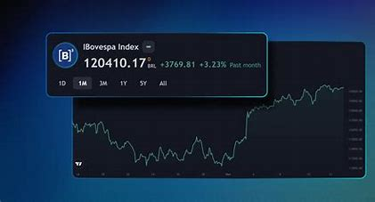
References
TradingView Widgets Documentation. Available at: https://www.tradingview.com/widget/](https://www.tradingview.com/widget/
2. React.js Documentation. Available at: https://reactjs.org/docs/getting-started.html](https://reactjs.org/docs/getting-started.html
3. Node.js Documentation. Available at: https://nodejs.org/en/docs/](https://nodejs.org/en/docs/
4. MongoDB Documentation. Available at: https://www.mongodb.com/docs/](https://www.mongodb.com/docs/
5. Express.js Documentation. Available at: https://expressjs.com/](https://expressjs.com/

Slide 9
Thank You

